Slide 1



About me
@erikmonchen
http://bit.ly/emonchen
Erik Monchen emo@sqlpass.de
Based in Munich, Germany
Team Lead at DYMATRIX Consulting Group GmbH
SQL Server / BI since 2008
PASS Member since 2004
PASS Chapter Leader since 2016
Almost booked a trip to the wrong city for SQL Saturday

Slide 2
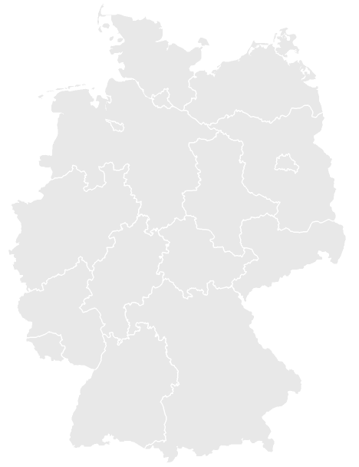
About DYMATRIX
Leading solution provider for business intelligence, big data analytics & marketing automation / campaign management
Hamburg
Everything from a single source - consulting, software and implementation through to campaign management as a service
Over
80
committed
employees
Cross-industry know-how from over 1,500 projects in medium-sized companies, large DAX-listed companies, specialist providers and market leaders
Cologne
in 4 locations
Over 18 years of experience & expertise = more than 200 satisfied customers at home and abroad
Stuttgart
Munich

Slide 3
Agenda
Business Case
Scope
Little theory
Execution (demo)

Slide 4
Business Case
On-premise SQL Server Environment
60 Million new records per day
2 months of data on fast storage, rest on slow

Slide 5
Scope
Monthly process of cleaning and moving data
How to move data from fast to slow storage?
How to make use of partitioning?
How to avoid using the DELETE-statement?
Out of scope
Computing power
Storage capacity

Slide 6
Execution
Tables
Partition scheme and function
Indices

Slide 7
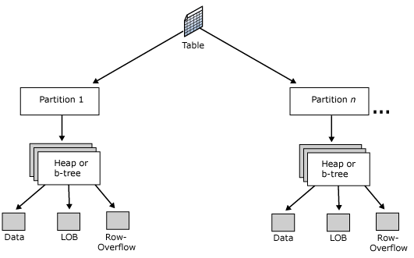
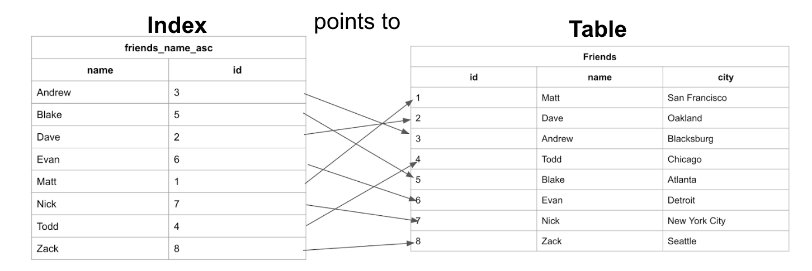
Before we dive in…
What are Partitions?
What are Indices?

Slide 8
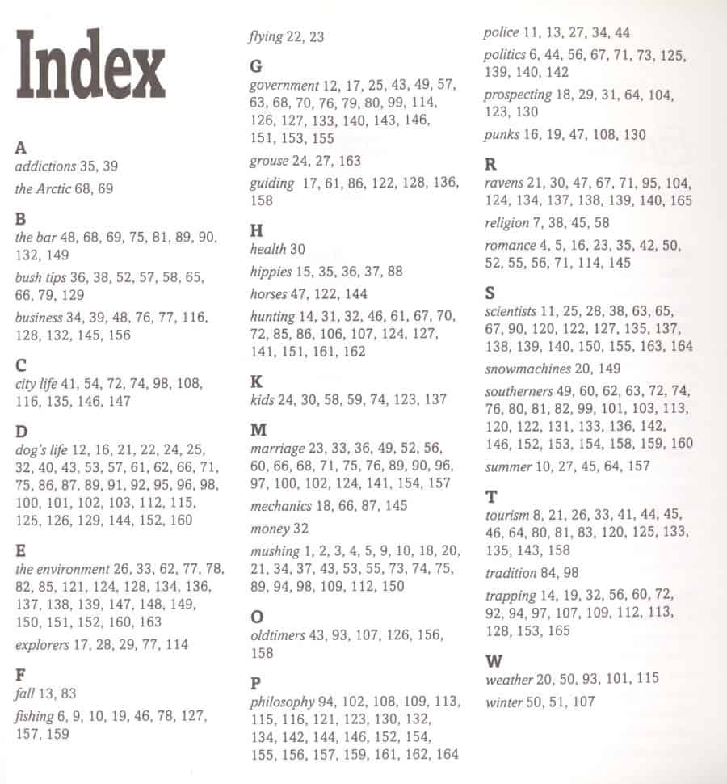
Before we dive in…
What are Partitions?
What are Indices?

Slide 9
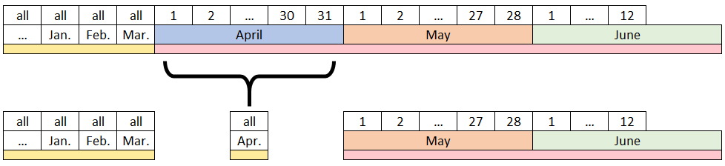
Example Dataset and Partitions

Slide 10
Demo time!

